Slide 1

C Programming Introduction
Week 5:Expressions
Lecturers : Cao Tuan Dung
Dept of Software Engineering
Hanoi University of Technology
For HEDSPI Project

Slide 2
Topic of this week
Expressions
  Class Lecture Review
    mathematic operators
    boolean operators
    conditional expressions
  Programming Exercises

Slide 3
Expression and Operations
Arithmetic Operators
  Addition +
  Subtraction -
  Multiplication *
  Division /
  Modulation %
Example
  fag = x % y;
  c = a – (a/b)*b;
  sum = var1 + var2 + var3;

Slide 4
Expression and Operations
Operator precedence
  Some arithmetic operators act before others (i.e., multiplication before addition)
    Use parenthesis when needed
  Example: Find the average of three variables a, b and c
    Do not use: a + b + c / 3
    Use: (a + b + c ) / 3

Slide 5
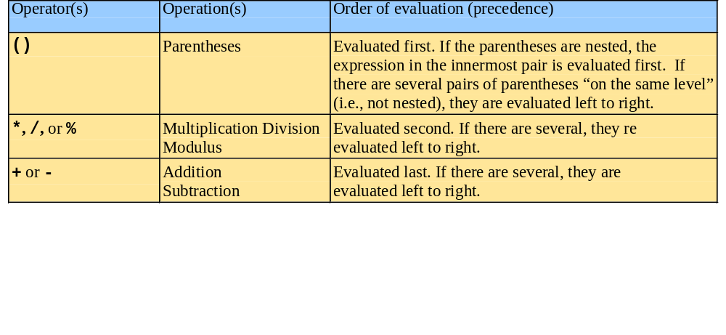
Expression and Operations
Rules of operator precedence:

Slide 6
Decision Making: Equality and Relational Operators
Executable statements
  Perform actions (calculations, input/output of data)
  Perform decisions
    May want to print "pass" or "fail" given the value of a test grade
if control structure
  Simple version in this section, more detail later
  If a condition is true, then the body of the if statement executed
    0 is false, non-zero is true
  Control always resumes after the if structure
Keywords
  Special words reserved for C
  Cannot be used as identifiers or variable names

Slide 7
Decision Making: Equality and Relational Operators
Relational Operators
  Less than < a < 5
  Less than or equal <= a <= b
  More than > a > b + c
  More than or equal>= a >= b + 5
  Equal == a == -6
  Not equal != a != 0

Slide 8
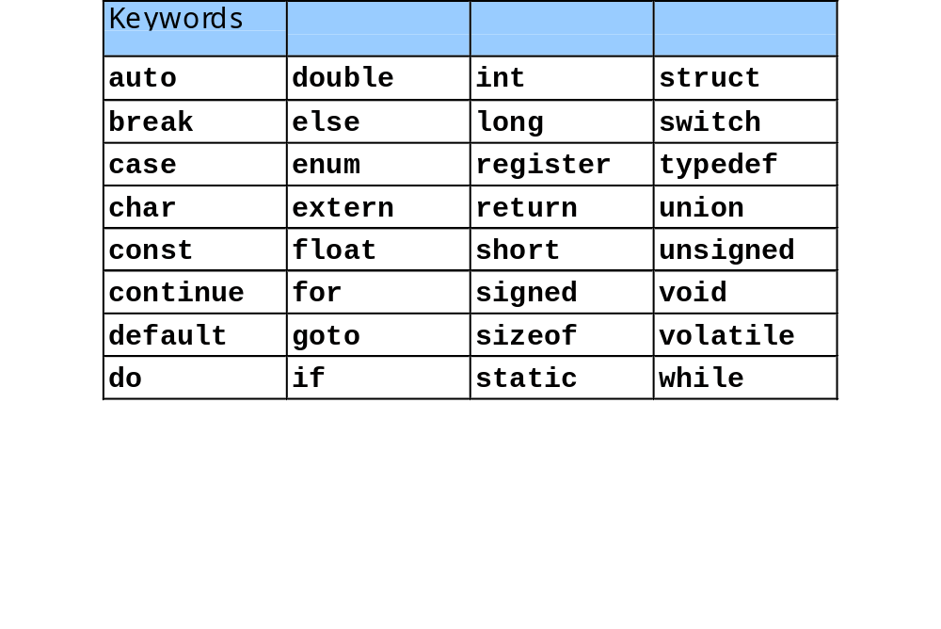
Decision Making: Equality and Relational Operators

Slide 9
Example 1
Using if statements, relational
2 #include <stdio.h>
3
4 int main()
5 {
6 int num1, num2;
7
8 printf( "Enter two integers, and I will tell you\n" );
9 printf( "the relationships they satisfy: " );
10 scanf( "%d%d", &num1, &num2 ); /* read two integers */
11
12 if ( num1 == num2 )
13 printf( "%d is equal to %d\n", num1, num2 );
14
15 if ( num1 != num2 )
16 printf( "%d is not equal to %d\n", num1, num2 );
17
18 if ( num1 < num2 )
19 printf( "%d is less than %d\n", num1, num2 );
20
21 if ( num1 > num2 )
22 printf( "%d is greater than %d\n", num1, num2 );
23
24 if ( num1 <= num2 )
25 printf( "%d is less than or equal to %d\n",
26 num1, num2 );

Slide 10
27
28 if ( num1 >= num2 )
29 printf( "%d is greater than or equal to %d\n",
30 num1, num2 );
31
32 return 0; /* indicate program ended successfully */
33 }
Enter two integers, and I will tell you
the relationships they satisfy: 3 7
3 is not equal to 7
3 is less than 7
3 is less than or equal to 7
Enter two integers, and I will tell you
the relationships they satisfy: 22 12
22 is not equal to 12
22 is greater than 12
22 is greater than or equal to 12

Slide 11
Expression and Operations
Logical Operators
  AND && (a > 0) && (b > 0)
  OR || (a <= 0) || (b <= 0)
  Negation ! !(a && c)

Slide 12
Expression and Operations
Bitwise Operators
  Bitwise AND &
  Bitwise OR (Inclusive OR) |
  Bitwise XOR (Exclusive OR) ^
  Left shift <<
  Right shift >>
  One's complement ~
Example
  x = 01001011 y = 00101100 ~x = 10110100
  x & y = 00001000 x | y = 01101111
  x ^ y = 01100111 x << 2 = 00101100

Slide 13
Expression and Operations
Assignment Operators and Expressions
  op is + - * / % << >> & ^ |
  If expr1 and expr2 are expressions, then
  expr1 op= expr2
  Equivalent to
  expr1 = (expr1) op (expr2)
Example
  X += 1;
  X = X + 1;
Equivalent

Slide 14
Expression and Operations
Conditional Expressions
  expr1 ? expr2 : expr3
  If expr1 is true do expr2
  If expr1 is false do expr3
Example
  a = 5;
  b = 10;
  min = a < b ? a : b;

Slide 15
Expression and Operations
Increment and Decrement Operators
  Pre-increment operation ++variable
  Post-increment operation variable++
  Pre-decrement operation --variable
  Post-decrement operation variable--
Example
  x = 4;
  y = x++ + 5; // x = 5, y = 9
  x = 4;
  y = ++x + 5; // x = 5, y = 10

Slide 16
Expression and Operations
Type Cast Operator (Casting)
  (type-specifier) expression;
Example
  (double) date;
  fload var1 = 2.7;
  int var2 = (int) var1; //var2 = 7
  (char) x;
  (int) d1 + d2;

Slide 17
Exercise 5.1
Write a program that converts distances from kilometers to miles.
Ask user to input the kilometers value then output to screen the miles value.

Slide 18
Solution
#include <stdio.h>
/* printf, scanf definitions*/
int main(void)
{
double miles, /* distance in miles */
kms; /* equivalent distance in kilometers */
/* Get the distance in kilometers. */
printf("Enter the distance in kilometers > ");
scanf("%lf", & kms);
/* Convert the distance to miles. */
miles = 1000 * kms;
/* Display the distance in miles. */
printf("That equals %f miles.\n", miles);
return (0);
}

Slide 19
Exercise 5.2
Run the exercise5_2.c program below to illustrate the operation of Logical operators and relational operators.
Replace b - a == b – c by a = b-c and then explane the result.

Slide 20
exercise5_2.c
#include <stdio.h>
main()
{
int a = 5, b = 6, c = 7;
puts("int a = 5, b = 6, c = 7;\n");
printf("The value of a > b is \t%i\n\n", a > b);
printf("The value of b < c is \t%i\n\n", b < c);
printf("The value of a + b >= c is \t%i\n\n", a + b >= c);
printf("The value of a - b <= b-c is\t%i\n\n", a - b <=b- c);
printf("The value of b - a == b - c is\t%i\n\n",b- a==b- c);
printf("The value of a * b != c * c is\t%i\n\n",a * b<c * c);
}

Slide 21
Exercise 5.3
Type and compile the exercise5_3.c below, the program illustrates the operation of conditional expressions.
Alter the program by eliminating the abs and max variables.

Slide 22
exercise5_3.c
#include <stdio.h>
main()
{
int n, m, abs, max;
printf("Enter a positive or negative integer: ");
scanf("%i", &n);
printf("\nYou entered %i.\n", n);
abs = n < 0 ? -n : n;
printf("Its absolute value is %i.\n", abs);
printf("\nEnter two integers (e.g. 1 2): ");
scanf("%i %i", &n, &m);
printf("\nYou entered %i and %i.\n", n, m);
max = n > m ? n : m;
printf("%i is the larger value.\n", max);
}

Slide 23
Exercise 5.4
This example illustrates the integer overflow that occurs when an arithmetic operation attempts to create a numeric value that is larger than can be represented.
Type and compile the program to see the result.

Slide 24
exercise5_4.c
#include <stdio.h>
#include <limits.h>
void main(void)
{
unsigned int x = UINT_MAX - 1;
signed int y = INT_MAX - 1;
printf("x is an unsigned int, occupying %i bytes.\n\n", sizeof(x));
printf("The initial value of x is %u\n", x);
x++;
printf("Add 1; the new value of x is %u\n", x);
x++;

Slide 25
exercise5_4.c
printf("Add 1; the new value of x is %u\n", x);
x++;
printf("Add 1; the new value of x is %u\n", x);
printf("\ny is a signed int, occupying %i bytes.\n\n", sizeof(y));
printf("The initial value of y is %i\n", y);
y++;
printf("Add 1; the new value of y is %i\n", y);
y++;
printf("Add 1; the new value of y is %i\n", y);
y++;
printf("Add 1; the new value of y is %i\n", y);
return;
}

Slide 26
Exercise 5.5
Write a program that requires user to input two double values stored in two variables x,y.
Use if control structure to examine all the relation between x and y.

Slide 27
Solution
#include <stdio.h>
main()
{
double num1, num2;
printf( "Enter two doubles, and I will tell you\n" );
printf( "the relationships they satisfy: " );
scanf( "%f%f", &num1, &num2 ); /* read two integers */
if ( num1 == num2 )
printf( "%f is equal to %f\n", num1, num2 );
if ( num1 != num2 )
printf( " %f is not equal to %f\n ", num1, num2 );

Slide 28
Solution
if ( num1 < num2 )
printf( "%f is less than %f\n", num1, num2 );
if ( num1 > num2 )
printf( "%f is greater than %f\n", num1, num2 );
if ( num1 <= num2 )
printf( "%f is less than or equal to %f\n",
num1, num2 );
if ( num1 >= num2 )
printf( "%f is greater than or equal to %f\n",
num1, num2 );
return 0; /* indicate program ended successfully */
}

Slide 29
Exercise 5.6
A group of n students is to be divided into 7 classes, as evenly as possible. (No class size should differ by more than 1 student when compared to all other class sizes.) Write a C expression for:
  the number of students in the smallest class
  the number of students in the largest class
  the average number of students per class;
  the number of classes of above average size;
  the number of classes of at most average size;
  the number of students in classes of larger than average size;
  the number of classes of exactly average size.

Slide 30
Solution
7(a) n / 7
7(b) (n + 6) / 7 , NOT n / 7 + 1.
  Both expressions give the same result, except when n is divisible by 7. In this case, n/7+1 gives the wrong answer.
7(c) n / 7.0
7(d) n % 7
7(e) 7 - n % 7 (would be trickier if asked for *below* average ...)
7(f) (n % 7) * ((n + 6) / 7)
7(g) (n % 7 == 0) * 7 or ! (n % 7) * 7

